Slide 1


Slide 2
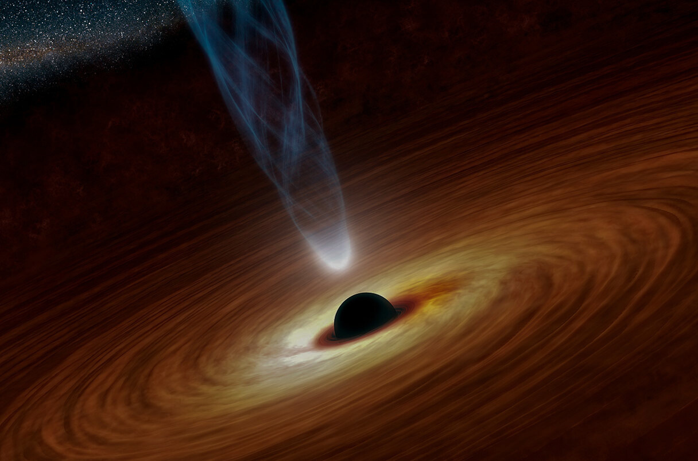
Our Team
Raahim Rizwan CTDS-15
Huzaifa Baig CTDS-18
Areena Shiekh CTDS-04
Fatima CTDS-07

Slide 3
Introduction to Black Holes
What are Black Holes?
Black holes, captivating and mysterious, stand as one of the most enigmatic phenomena in the cosmos. At their core, they are regions of space time where gravity is so intense that nothing,even light cannot escape them.
Their significance in astrophysics is profound, as they challenge our fundamental understanding of the fabric of space and time. Black holes play a crucial role in the evolution of galaxies, influencing their structure and dynamics.

Slide 4

Formation of Black Holes
Black holes come into existence through a cosmic spectacle known as stellar collapse. When a massive star exhausts its nuclear fuel, the outward pressure that balances gravitational forces ceases. Our Milky Way galaxy contains about 100 Million plus Black Holes.
Massive Star Criteria: Black hole formation is associated with stars that are typically more than about 20 times the mass of our Sun. This critical mass determines whether the remnant will become a neutron star or undergo further collapse to become a black hole.
Chandrasekhar’s Limit: The collapse of a massive star's core, triggered by surpassing Chandrasekhar's limit, can lead to the formation of a black hole. The limit is 1.4 * Mass of Sun.

Slide 5
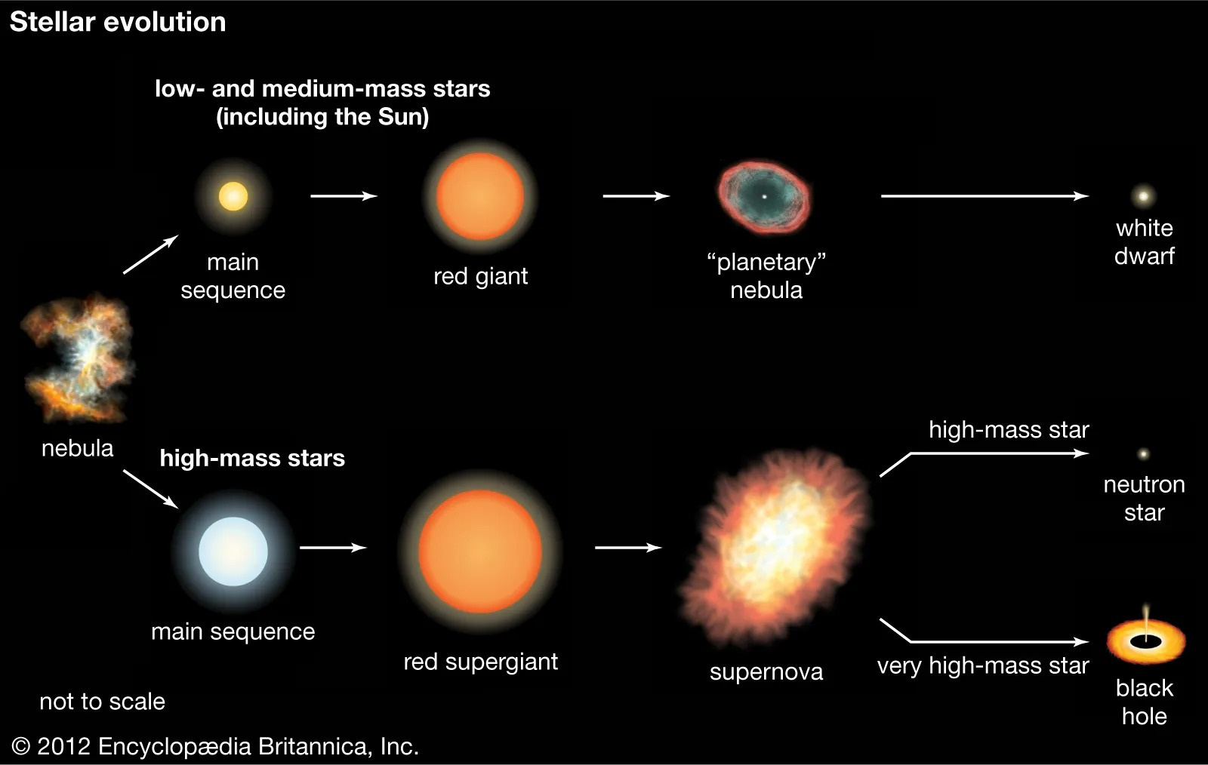

Slide 6
Types of Black Holes
Stellar Mass Black Holes:
Formation: If the star’s mass before explosion was around 20 times the Sun’s mass or more, the star’s core collapses into a stellar-mass black hole.
Mass: The masses of these newly born objects can range from a few to hundreds of times the Sun’s mass, depending on star’s mass when the supernova began.
Event Horizon: The event horizon is the boundary surrounding a black hole beyond which escape is impossible. Anything that crosses the event horizon is inevitably drawn into the black hole. The size of the event horizon is directly proportional to the mass of the black hole.
Singularity: The singularity in the context of stellar-mass black holes refers to the point at the very center of the black hole where gravitational forces become infinitely strong, and the density of matter becomes infinite.

Slide 7
Types of Black Holes
Supermassive Black Holes:
Formation: Scientists aren’t sure how these monster objects came to be.
Enormous Mass: Supermassive black holes have masses ranging from millions to billions of times the mass of our Sun (Solar masses).
Galactic Centers: They are typically found at the centers of galaxies, including our Milky Way. They play a crucial role in the dynamics and evolution of galaxies, influencing the movement of stars and gas within the galaxy.
Influence on Galaxy Evolution: Supermassive black holes have a profound impact on the evolution of their host galaxies. They can regulate star formation, drive galactic winds, and affect the distribution of matter within the galaxy.

Slide 8
Types of Black Holes
Intermediate Mass Black Holes:
Formation: Some IMBHs may have formed directly from the gravitational collapse of massive gas clouds in the early universe, similar to the formation of supermassive black holes.
Mass Range: Intermediate-mass black holes typically have masses ranging from hundreds to thousands of times that of our Sun (solar masses). This puts them in an intermediate range between stellar-mass black holes and supermassive black holes.
Role in Galaxy Evolution: Intermediate-mass black holes are thought to play a role in the dynamics and evolution of globular clusters and dwarf galaxies. They can influence the movement of stars within these systems and potentially contribute to the formation and maintenance of dense stellar environments.

Slide 9
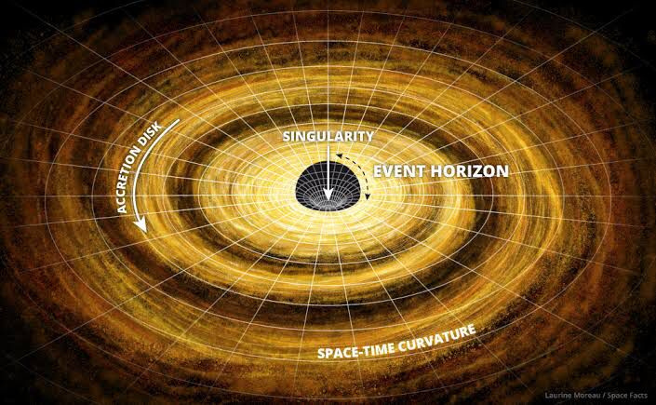

Slide 10
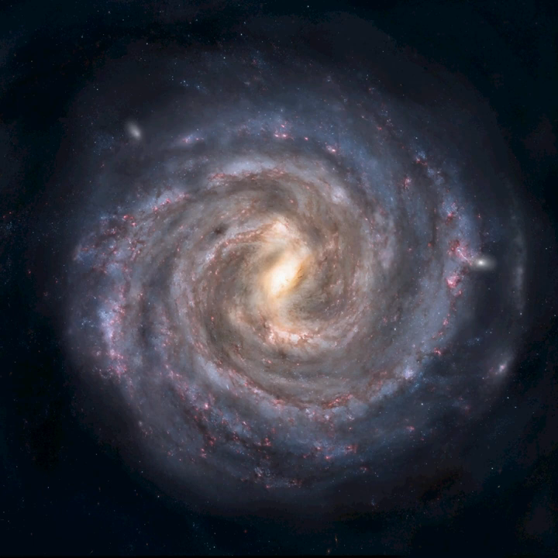
Detecting Black Holes
Indirect Detection Methods
Stellar Motion: We can find black holes by watching how nearby stars move. If they're dancing around in a strange way, there might be a hidden black hole.
Surrounding Matter: Black holes can affect the stuff around them. By studying how gas and other things behave nearby, we can tell if there's a black hole.

Slide 11
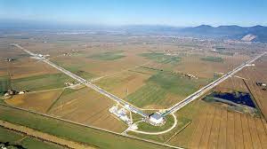
Detecting Black Holes
Direct Detection Methods
Gravitational Waves: Black holes send out ripples in the fabric of space and time. We can catch these ripples, called gravitational waves, to know if black holes are merging or doing other interesting things.
LIGO and VIRGO: These are special instruments that help us "see" gravitational waves. They're like giant detectors that pick up the signals from faraway black hole events.

Slide 12
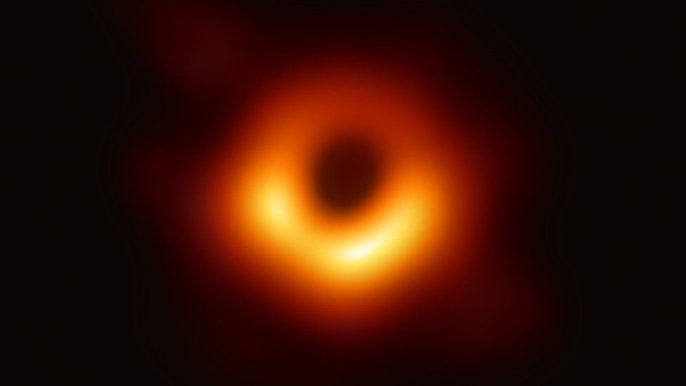
Detecting Black Holes
Notable Discoveries
Event Horizon Telescope (EHT): Scientists used a bunch of telescopes together to take the first-ever picture of a black hole's edge in 2017.
We're always finding new things about black holes. Every cool discovery helps us understand them and the universe better.
M87 - Messier 87 Black Hole

Slide 13
Hawking Radiations
Hawking radiation is black body radiation which is emitted by black holes, due to quantum effects near the event horizon. It is named after the physicist Stephen Hawking, who provided a theoretical argument for its existence in 1974.
Now, think about black holes as giant cosmic vacuum cleaners. They suck in everything, even light. But around the edge of a black hole, there's a special area called the "event horizon." Hawking figured out that, at this edge, really tiny particles (like mini-bits of stuff) are always popping in and out of existence.

Slide 14
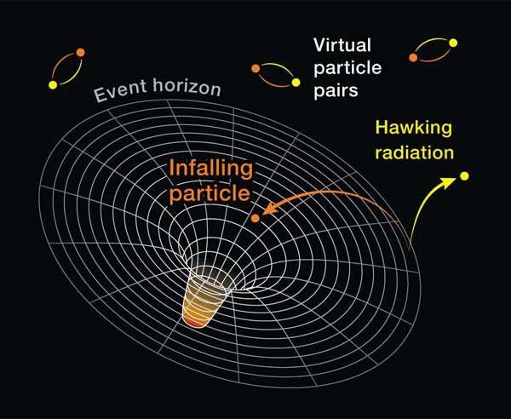
Hawking Radiations
Hawking had a big idea! He said, "Hey, even though nothing can escape a black hole, what if one of those tiny particles pops out just at the right moment?" It's like a magical escape trick. This escape could create a very faint glow, like a whisper of light, and that's what he called "Hawking radiation.”

Slide 15
Black Holes and the Universe
Formation of Galaxies: As the black holes grew, they released immense radiation and energy in the form of quasars. This heated up and ionized the surrounding gases, preventing further star formation in the region. This process is called FEEDBACK and it regulates growth of galaxies.
Impact on Galaxies: Black holes can shape the dynamics of galaxies by influencing their motion, distribution, and evolution gases and radiation within surrounding galaxies.
Black hole mass and galaxy characteristics: The mass of black hole can impact the rate of star formation within a galaxy. High mass black holes release immense radiation which heat up and disrupt the surrounding gas clouds.

Slide 16
Unsolved Mysteries of Black Holes
Beyond the Event Horizon: The event horizon is a boundary and beyond this nothing can escape the black hole’s gravitational pull. However, this information is still based on hypothetical models and experiments.
Quantum Mechanics and GR: These both combine are known as ‘QUANTUM GRAVITY’. It seeks to provide a consistent description of the behavior of matter and energy at small and large scales particularly in the presence of strong gravitational fields like those found near black holes.
Spaghettification: When an object gets too close to black hole, the intense gravitational pull stretch it like a spaghetti. This happens because force from black hole is stronger which causes it to be stretch. Imagine a matter turning into thin long noodle.

Slide 17
Exploring the Cosmos’ Dark Corners
As we conclude our journey into the cosmos' dark corners, the exploration of black holes leaves us with a profound appreciation for the mysteries and wonders of the universe. Let's recap the key points of our expedition:
Formation and Variety: We've delved into the various processes leading to the creation of black holes, from the collapse of massive stars to the birth of supermassive black holes.
Characteristics: From the event horizon, the boundary beyond which nothing can escape, to the singularities at their cores, black holes possess characteristics that challenge our understanding of space, time, and gravity.
Hawking Radiations: : Although black holes themselves remain invisible, we've explored the ingenious methods astronomers use to detect their presence, including the recent breakthroughs in gravitational wave astronomy.

Slide 18
